Slide 1
Software Lifecycle and Introduction to UML
By PJ Davies
With Reference to:
  Real-Time UML by BP Douglass.
  ISBN 0-201-65784-8
Using the link on Canvas, please download the Visual Paradigm UML tool
Please begin the process of gradually reading topics 1-5 on Canvas after today’s lecture
©Paul Davies 2020. Not to be copied, used, or revised without explicit written permission from the copyright owner. This lecture may contain animations and is best viewed as a slide show

Slide 2
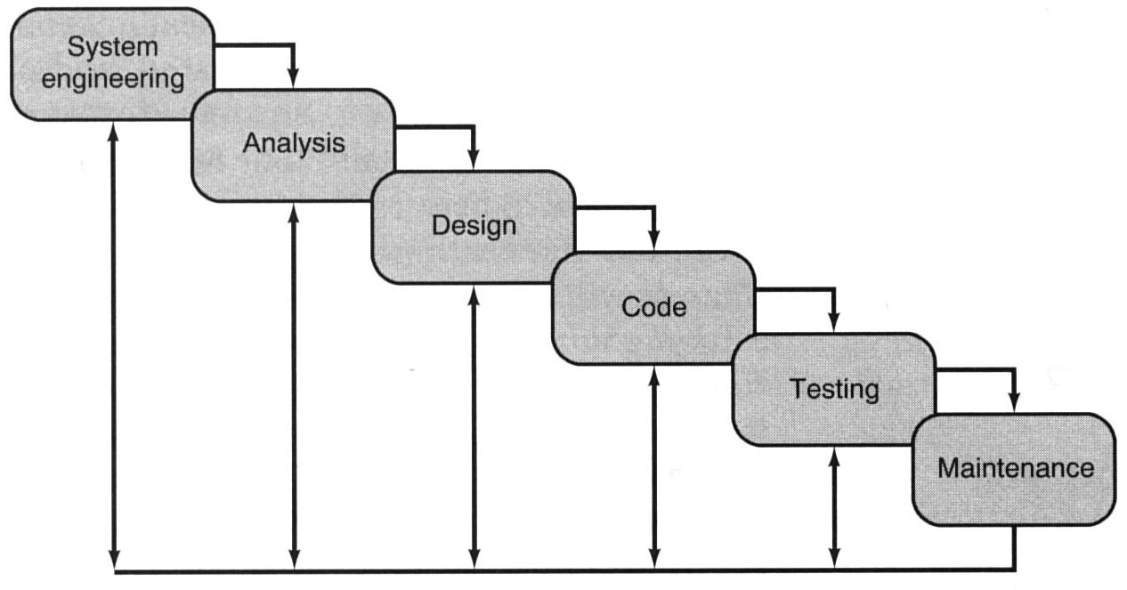
The Traditional Software Life Cycle
The development of any complex software system, requires that a number of steps be followed in order to arrive at a successful conclusion.
The traditional software life-cycle paradigm implies a sequential approach (rarely achieved in practice) to software development beginning at the system level and progressing through requirements and architectural analysis, design, coding, testing and maintenance. (read Topic 4 on Canvas)
The arrows pointing backwards imply that in reality each stage ends up being revisited as part of an iterative process of SW development, often due to changes of spec.
Software Life Cycle or Waterfall model of software development

Slide 3
What happens during System Engineering phase – what do we seek to uncover?
Attempt to get an overview of the system – e.g. Where does the software fit, i.e. attempt to establish the boundary between the system we are about to build and the world/users/other systems that it interacts with.
What kind of system is it?: Tax or Payroll? A Robot on a production line? Perhaps it’s a Library Loaning system, a student management system at a university, a Hotel reservation system etc.
What environment will the system be placed in:
  Hostile, such as an elevator controller subject to vibration, heat and dust, or some kind of friendly air-conditioned office?
  Will the customer constrain the solution e.g. Will it be ‘web-based’, an ‘app’, will it be ‘real time’, ‘safety critical’, ‘fault tolerant?’ Will it have to run on a PC, a phone or a micro-controller. Will it run with an operating system or “Bare Metal”? What programming language will we have to use?
  Cont…

Slide 4
Is the system a completely new product, or is it designed to replace a mechanical or human activity – if the latter, what can we learn from how it is done now?
What performance requirements exist? For real-time systems response time will be important. For databases, search speed will be important. For an on-line system the numbers of simultaneous uses will be crucial.
Fast usually means expensive, real-time or safety critical might need certification from a licensing authority (more expense) as well as mathematical proofs of correctness.
What time line has been proposed and how critical is it. Will you need to hire more developers and contractors. Do you have the “in-house” expertise to develop that kind of system?
What budget is available and is it realistic. Perhaps the customer will need to be re-educated about the cost.

Slide 5
What happens during Analysis phase?
Focus is on identifying WHAT needs to happen NOT HOW it will happen.
Who are the users/stake holders (e.g. students, professors, staff, librarians, Jeff in accounts, Mary in purchasing etc) what functionality does each user require from the system. i.e.
  What are their “Functional Requirements”?
In particular
  What data comes in from real world/users?
  What data goes out to real world/users? e.g. names, S.I.Ns, reports etc.
  What processing is performed on the data? e.g. calculate tax, book hotel etc.
  What is the effect on the system and the outside world of that processing?
Analysis builds simple models of the users interaction with the system and the information processing that takes place within it.

Slide 6
More Detailed Analysis
Once functional requirements have been gathered and understood, more detailed analysis is performed that attempts to build a set of models of the system that capture:-
  An Architecture of the system as a set of cooperating Objects
  A set of classes from which those objects will be built.
  The interaction between those objects at run time (i.e. which objects communicate, what messages and data are sent between them)

Slide 7
What happens during Design and Coding?
Focus switches to HOW (i.e. making implementation decisions). Turning analysis models into detailed design models and from then, into code
Models are especially important with large projects involving many developers over a long period of time. In particular we interview users and build models to answer questions such as those below:-
  Development Approach: Conventional or could AI and Machine Learning help.
  Software Architecture – Capture Components, Sub-systems and Objects from which the system will be built and how they will interact. These could be captured on detailed Class and Sequence diagrams in UML.
  Deployment platform model: Mobile, Cloud, Web, PC or Micro Controller.
  User Interface design: Menus, Buttons, Look & Feel, Help, User Navigation etc.
  Possible Database design (relationships, multiplicities)
  H/W interfaces e.g. Disks, Graphics, Internet, Bluetooth. External sensors and actuators: A/D and D/A – PID control systems, that kind of thing.
  Choices related to Language, Algorithms and Translation to code.
  Data representation and storage: Linked lists, Databases, disk storage, non-volatile memory.

Slide 8
Software Life Cycle or Waterfall model of software development
Problems with Waterfall model
One of the major problems with this approach is that it assumed a once-only delivery of a big monolithic monster of a program, all in one single software release.
Potentially high risk activities such as interfacing the system to an unknown database, using unknown tools, hiring staff that are not familiar with them or miss-perception of user requirements are not addressed early enough, leading to delays and cost-overruns towards the end of the project, just when they are not needed.
Does not deal well with changing or vague requirements.
Finally unless multiple projects are on-going, it leads to poor staff utilisation, analysts are only employed at the beginning of a project and testers only at the end.

Slide 9
Incremental and Iterative Development
These days software is developed incrementally using iterations of the waterfall model where a new release of the software is delivered to the customer each time some new significant functionality has been developed and tested.
Such development is just the repeated application of the life cycle model to a subset of the software's functionality, i.e. pick a particular piece of functionality required by a user: Analyse, Design, Code and Test it, then ship it as a new partial release to the customer. This approach has significant attractions:-
  You get immediate short term feedback from the customer when you have done it correctly and also when you have done it wrong. This helps keep you on track with what the customer wants, thus you can correct any bugs or tackle misunderstandings in the next release.
  You get paid during the development, for each release of the code, rather than just getting paid at the end (important for cash flow).
  You keep your staff fully utilised. For example, while the testers are kept busy testing the 1st release, the coders are writing the 2nd release and the analysts are figuring out what is needed for the 3rd release.

Slide 10
How are design ideas communicated in a team environment?
If the software is large scale, employing perhaps dozens of developers over several years, it is important that all members of the development team communicate using a common language.
This isn’t meant to imply that they all need to be fluent in English or C++, but it does mean that they need to be able to describe their software’s operation, interface and design to another person.
That is, the ideas in the head of say the analyst have to be conveyed to the designer in some way so that he/she can implement that idea in code.
Just as mathematicians use algebra and electronics engineers have evolved circuit notation to describe their ideas, software engineers have evolved their own notation for describing the architecture and behaviour of software systems.
That notation is UML, the Unified Modelling Language. Some might prefer the title Universal Modelling language since it can be used to model many things besides software.

Slide 11
What do mean by a Common Notation and Language?
Example 1: If I drew this and showed it to high school math class, they would understand it instantly and be able to solve it – why? Because the notation of a right angled triangle and the use of Pythagoras is well understood, i.e. we have a common language and can reason about it and solve problems with it. A common language allows users to communication at high bandwidth without having to explain low level principles at each stage.
Try the same problem with a group of 6 year olds the result will not be the same.
?
3
4

Slide 12
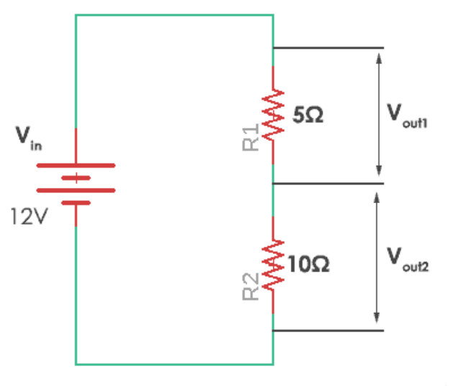
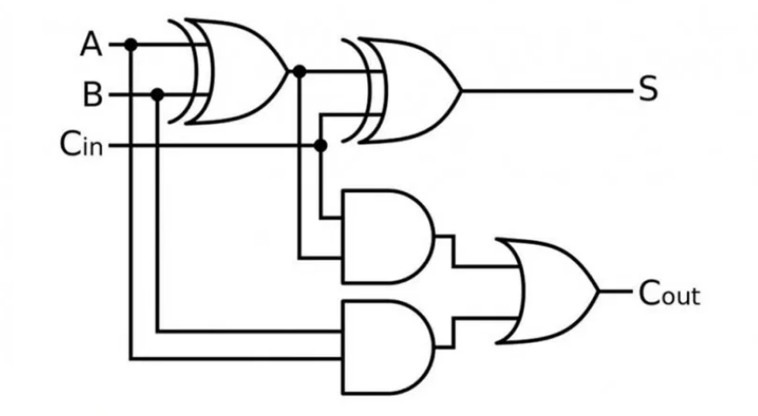
Example 2: If I drew this and showed it to 2nd year electrical engineers, they would also understand it and could easily solve for V_{out1}, V_{out2}, S and C_{out} because they understand electrical circuit notation, Ohms law and Boolean Algebra.
They also understand resistors and logic gate so they could quickly build that circuit from a simple sketch like this.
1
0
1

Slide 13
What is UML and how do we use it to model Software ?
UML is not a programming language like ‘C++’, or ‘Java’.
UML has syntax and semantics to convey meaning, (i.e. what is right and wrong) and the limitations of those decisions and thereby allows two people fluent in that language to communicate and understand the intent of the other very quickly.
UML represents a collection of graphical (i.e. drawing) notations supplemented by textual descriptions designed to capture requirements and design alternatives. You don’t have to use all the diagrams every time you develop something, you just choose the ones that capture important information and decisions about the system you are working on.
UML is to software engineers, what building plans are to an architect and a circuit diagram is to an electrical engineer.

Slide 14
How is UML Used?
  Some developers use it lightly, informally, documenting just enough ideas to allow a team to understand the big picture of how things will work.
  Some developers use a much more formal approach to UML , full of diagrams with rich UML syntax. This can be useful when you want to use a tool to generate “code” from the model (model driven development - MDD) or you absolutely must have comprehensive documentation for a customer or certification body.
What kinds of project do NOT generally use UML?
Small projects with perhaps 2 or 3 developers working for just 1-2 weeks on a simple application. UML is less commonly used here because the project is simple enough to figure out in the developers heads and they can just build it.
What kinds of project DO generally use UML?
Projects involving a large team working 6+ months on something that is perhaps real-time, safety critical, or just very complex. Examples might include projects for government or military use etc. Its use is often mandated in safety critical applications e.g. medical applications, power stations, aircraft systems, military, railway signalling etc.

Slide 15
It’s also worth noting that there are many developers who hate modelling, whether it is UML or something else and prefer to jump straight into code.
They argue that the “code” is the model so why document things in two places?
It is easy for the model and the code to get “out of sync” once coding takes over.
But let’s look at it this way. If you were going to design and build something complex like a new car or airplane, that you know is going to take a team of 100 engineers 3-5 years to design, would you really just jump into a “bricks and mortar” build and start “metal bashing” without some high level design plan or architecture and at least some discussion about the parts needed and how they will interact.
You might get away without a model, architecture or plan for a “dog kennel” but not for a safety critical system where someone could die if you screw up !!!
The People who don’t get this, will never understand why they need UML or even anything other than programming skills. They will eventually find out the hard way when a big project goes “off the rails”.
Problem: Think about some major design you have done, how well it went (or didn’t) and how much time you put into design before building. Think about your first assignment in 333. What model did you have, who did the analysis, what waterfall model phase are you involved in? Would it have been as successful without the model?

Slide 16
Question:
What models exist in your engineering disciplines such as
  Electrical,
  Computer,
  Civil,
  Mechanical,
  Production Engineering etc.
How are these models helpful to everybody involved?
What kinds of diagrams exist in UML to model Software?
There are more than 15 UML diagrams, 7 of which are important, and 3 of which pretty much always get used. The remainder can be used when they add value, or increase understanding.
See here for a brief overview of UML diagrams
https://www.uml-diagrams.org/

Slide 17
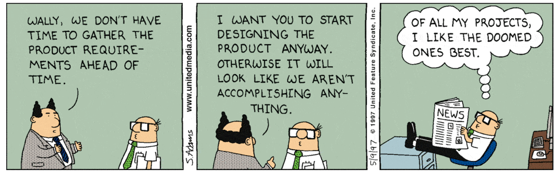
Projects usually begin with Requirements Analysis (Part of the Analysis Phase)
It’s an attempt to document the functionality of the system (i.e. what the system is required to do to satisfy its users.)
It’s a time consuming process that involves interviewing lots of users and documenting their needs so that developers can build the system.
While this is taking place, nothing is being built or tested, but it’s essential to building the “right” software.
If you attempt to code before requirements are understood, it will end in tears.
Source: Dilbert.com

Slide 18
Capturing Functional Requirements in UML: "Use Case” Diagrams
This model is CRUCIAL. Without it, it’s unlikely you will deliver the functionality the customer wants.
Use-case diagrams are a simple but very effective model created during requirements analysis by exploring user interactions with the system.
That is, it attempts to uncover and document the services (i.e. functionality) the system must provide to satisfy its users.
Use case analysis explores and documents
  Who the users of the system are
  Who initiates an interaction with the system,
  What information goes into the system,
  What information comes out
  What the measurable benefit is to the user who initiates the interaction (i.e. what they get out of it).

Slide 19
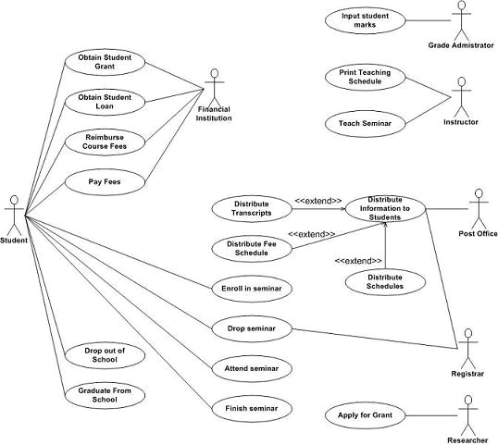
Example Use-case Diagram for a Student Information system
Problem: Think about a very simple use-case diagram for the Lamp problem from Lab 1

Slide 20
Examples of Other
UML Diagrams
(these will be covered later)

Slide 21
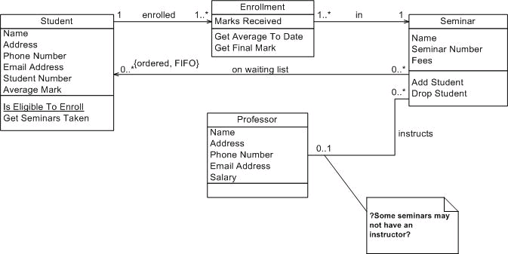
Capturing Architecture : UML “Class” Diagrams
A powerful model for capturing the static (compile time) structure of the software which is helpful in creating a software architecture and identifying relationships between objects in our system (i.e. instances of classes).
A class diagram captures class relationships and multiplicities, which tell us how many objects are needed, which objects communicate. It gives us a template for coding.
Classes are the building blocks of our system e.g. Bulb, Switch, Lamp etc.
Example Class Diagram model from a University software system for enrolling students in seminars
Problem: Think about a class diagram for the simple Lamp problem from Lab 1

Slide 22
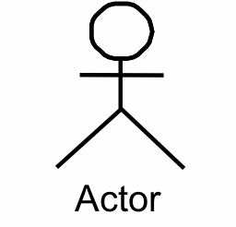
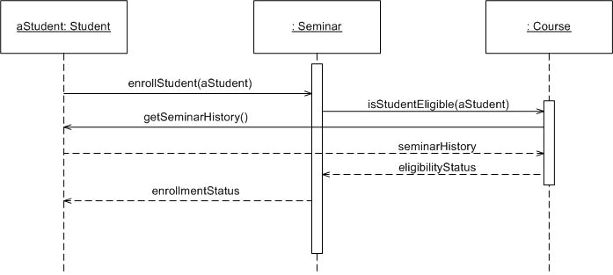
UML Sequence and Communication Diagrams
These two diagrams model the interaction of a set of collaborating objects through a process of message passing as they attempt to achieve the functionality expressed in one or more use cases.
They model the behaviour of our system in response to inputs from the user.
UML Tutorial is an instance of a “seminar” class
CPEN 333 is an instance of a “course” class
User
Message
UML Tutorial : Seminar
CPEN 333 : Course
Result
Example Sequence diagram for enrollment in a seminar in CPEN 333
Problem: Think about a sequence diagram for the Lamp problem from Lab 1

Slide 23
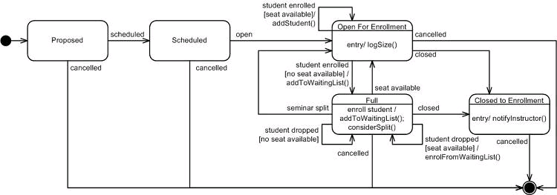
Modelling Dynamic Object Behaviour : UML State Charts
An extension of state transition diagrams.
The behaviour of some objects and systems changes with time and past events. That is, the same input or event may not always produce the same response, e.g. pressing “play” on a DVD where the response depends upon the current state of the DVD player (i.e. disk loaded/not loaded etc.)
For objects with state driven behaviour, we capture that with a state chart.
State
State Transition following an event
Starting State
State Chart for a Seminar Object
Terminating State

Slide 24
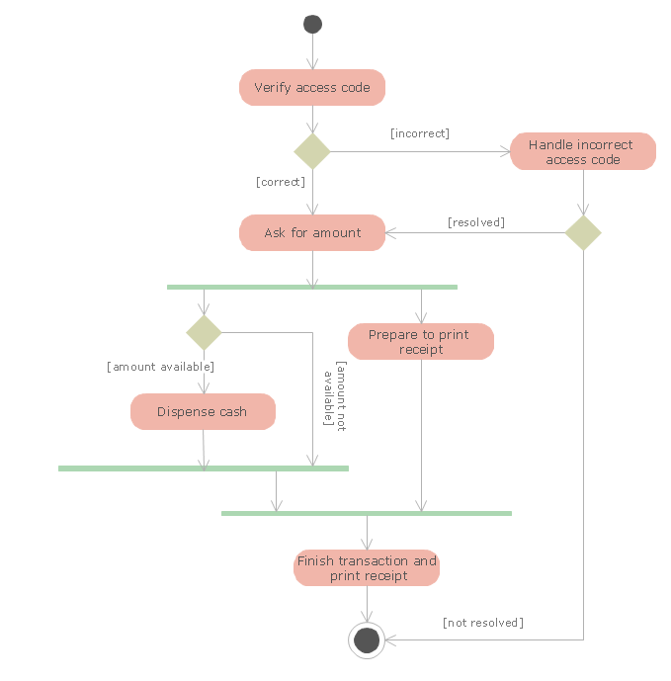
Contains elements of a high level flowchart capturing important business decision making, particularly elements of sequential and parallel operation within a business.
Example opposite shows a simple activity diagram for an ATM
Note the green horizontal lines denoting start and end of parallel activities – gives clues to concurrency in solution, e.g. software activities e.g. threads running in parallel, or perhaps used to model concurrent activities within a business e.g. shipping and raising an invoice at the same time.
Modelling Business Activities : UML Activity Diagrams

Slide 25
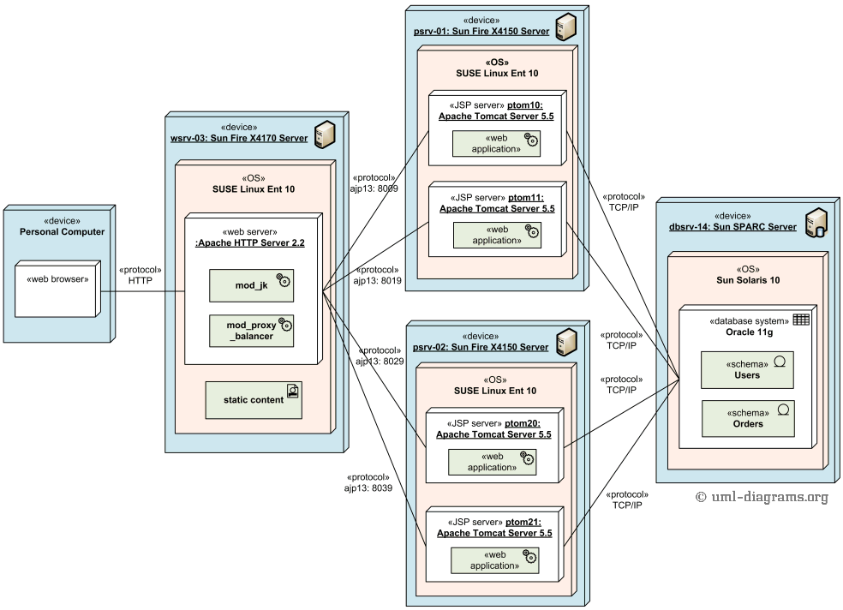
UML Deployment Diagrams:
Deployment diagrams capture how complex software and hardware will be installed on computers, networks, OS’s and services.
Weak syntax (anything goes) mainly for documentation and maintainability of system.

